Slide 1


Department of Artificial Intelligence and Data Learning
CrediSense: AI Driven Sanctions
Done By
Arul Kumaran P
221801004
Harish Raghavendra R
221801015
Guided By
Dr. J M Gnanasekar
Head of Department

Slide 2
Problem Statement and Motivation
The loan approval process is often labor-intensive, involving thorough manual reviews of applicants' financial data and credit histories.
This explains the long turnaround time, high costs, and possibly unequal loan distributions to deserving borrowers.
AI can be leveraged to solve these issues through the use of stacking classifiers, which could aid in promoting automatism and effective decision-making for loan approvals.

Slide 3
Objectives
The objective is to create a mortgage loan approval system that leverages a stacking classifier to evaluate applicant’s financial data and credit scores.
It will streamline the loan distribution process, and include a recommendation system for personalized loan valuations with risk assessments.
The system will enhance mortgage lending efficiency and accelerate approvals for lenders using quantitative techniques.

Slide 4
Abstract
In the field of mortgage lending, the traditional process is manual and time-consuming.
The existing system proposed a machine learning-based method to automate loan approvals but encountered issues with low accuracy and scalability.
The proposed system employs a stacking classifier, which integrates multiple machine learning models to analyze financial statement data and credit scores, minimizing human error.
Future developments will focus on real-time information analysis and incorporating additional financial ratios into the model to further refine its predictivity.

Slide 5
Introduction and Overview of the Project
In the mortgage lending industry, the loan approval process is often labor-intensive, involving thorough manual reviews of applicant’s financial data and credit histories.
Traditional methods can lead to prolonged processing times, higher operational costs, and inconsistent decision-making.
To overcome these challenges, we are developing a stacking classifier model.
The stacking classifier will integrate multiple machine learning models to analyze financial data and credit scores, aiming to reduce human intervention and errors.

Slide 6
Literature Survey
S. No | Author Name | Paper Title | Description | Journal | Volume/ Year
1 | Amruta S. Aphale | Predict Loan Approval in Banking System Machine Learning Approach for Cooperative Banks Loan Approval. | In this paper, we examine credit worthiness of customers in order to formulate bank risk automated system. | IJERT | Vol.9 August-2020
2 | Ashwini S. Kadam | Prediction for Loan Approval using Machine Learning Algorithm. | The objective is predicting the loan defaulters, the bank can reduce its Non-performing Assets with naïve bayes method. | IJERT | Vol.8 April- 2021
3 | Yash Diwate | Loan Approval Prediction Using Machine Learning. | The principle objective of this paper is to anticipate whether relegating the advance to specific individual will be protected or not using SVM algorithm. | IRJET | Vol.08- May 2021
4 | Goliya Bhavani | Loan Approval Prediction Using Machine Learning | The aim of this is quick, immediate and easy way to choose the better loan applicants using logistic regression. | IIJRPR | Vol.5- January 2024

Slide 7
Existing Sytem
The existing systems have started integrating Machine Learning (ML) algorithms to automate and improve the accuracy of the loan approval process.
The system involves rigorous data preprocessing steps, including cleaning the data, handling missing values, and feature extraction to improve model accuracy.
Uses algorithms such as Logistic Regression, Decision Trees, Random Forests, and Support Vector Machines Predict the likelihood of loan default based on historical data.

Slide 8
Drawback of Existing System
Limited Accuracy
Inflexibility to Complex Data Structures.
Difficulty in Generalization.
Limited Use of Model Strengths.

Slide 9
Proposed System
Enhanced Prediction Accuracy:
By combining the predictions of multiple base models through a meta-model, stacking classifiers generally achieve higher accuracy.
Better Generalization:
The stacking approach typically results in better generalization to new, unseen data.
Increased Robustness:
By leveraging multiple base models, your proposed system can handle a wide range of data scenarios and anomalies.

Slide 10
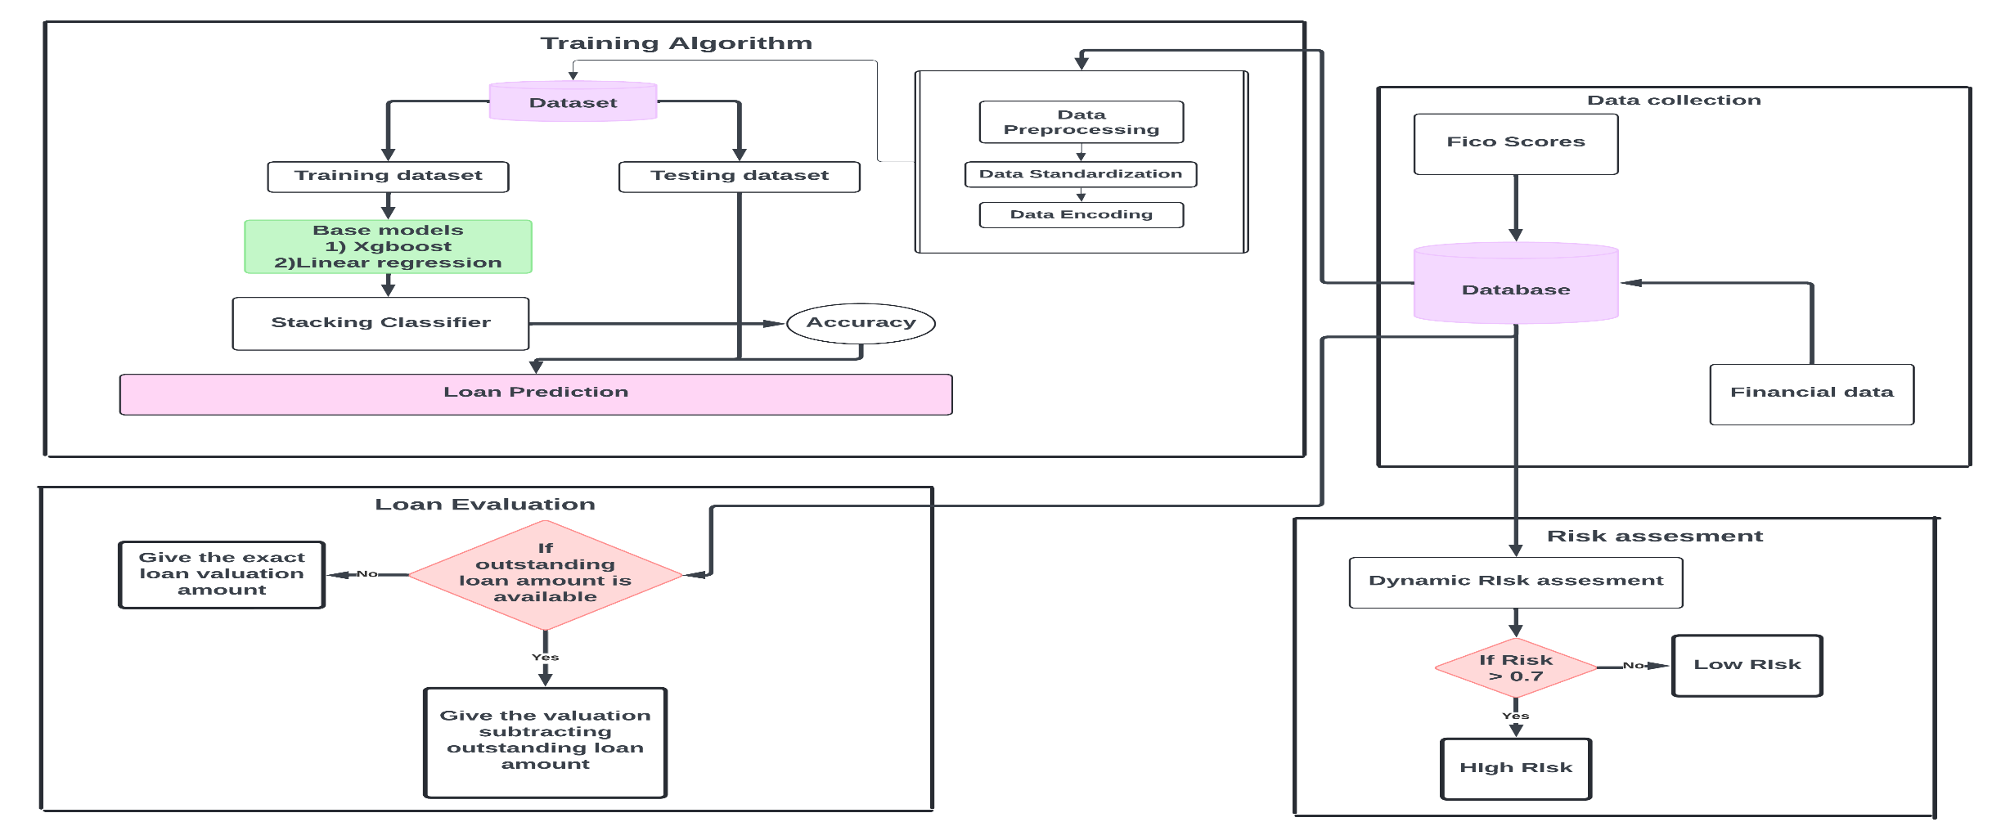
System Architecture

Slide 11
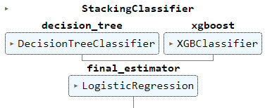
Methodology
Base Models (Level-0 Models):
These are the individual models that are trained on the original training data. Each base model is typically different in terms of algorithm or configuration.
Meta-Model (Level-1 Model or Stacker):
The meta-model is trained to make the final predictions based on the outputs (predictions) of the base models.

Slide 12


If there are m base models, then:
where f1,f2,…, fm​ are different machine learning algorithms
If H(X) is the set of predictions from the base models, the meta-model learns
The final model, 𝑓meta​ , could be any machine learning model, this model is trained to minimize the prediction error

Slide 13
Cross-Validation in Stacking:
To avoid overfitting, stacking often involves k-fold cross-validation. The base models are trained on 𝑘−1 folds, and predictions are made on the 𝑘-th fold. This prevents the meta-model from having overly optimistic predictions on the training set.
Example of k-fold Cross-Validation:
If K=5 (5-fold cross-validation), the dataset is split into 5 folds:
Train base models on folds 1-4 and predict on fold 5.
Train base models on folds 1, 2, 3, 5 and predict on fold 4.
Train base models on folds 1, 2, 4, 5 and predict on fold 3.
.

Slide 14
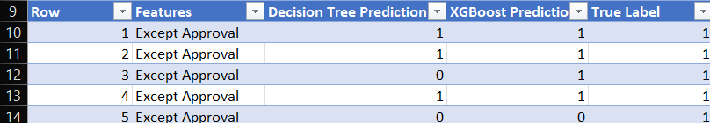
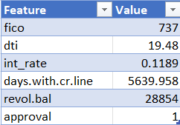

Slide 15
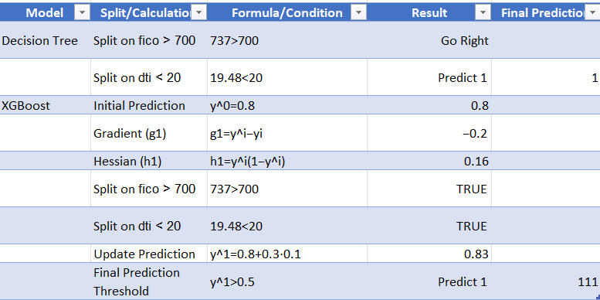

Slide 16
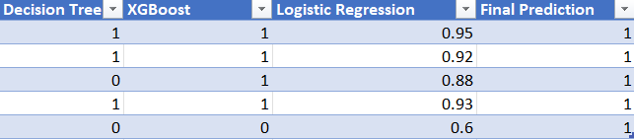

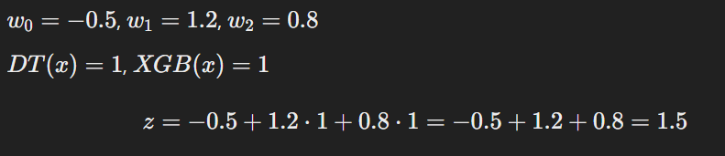

Slide 17
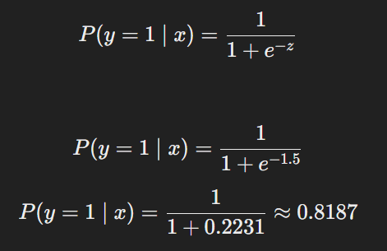
If the probability is greater than 0.5 predict y = 1.
Else predict y = 0.

Slide 18
Algorithm
Step 1: Load the Dataset: Import the dataset containing loan application details.Check for missing or inconsistent data and clean it if necessary.
Step 2: Encode Categorical Features: Identify categorical features (e.g., loan purposes).Convert them into numerical format using label encoding or other encoding methods.
Step 3: Select Important Features: Choose relevant features like dti, annual income, fico, revol.util, etc., for prediction. Remove irrelevant or highly correlated features to avoid redundancy.
Step 4: Visualize Feature Relationships: Plot a correlation heatmap or similar visualization to understand relationships between features. Ensure no multicollinearity exists among the features.

Slide 19
Step 5: Split the Dataset: Divide the dataset into training data (70%) and testing data (30%).
Step 6: Scale the Features: Standardize the numerical features (e.g., normalize income, DTI, etc.) to ensure consistent scales.
Step 7: Define Base Models: Use Decision Tree as the first base model.Use XGBoost as the second base model.
Step 8: Define Meta-Model: Use Logistic Regression as the meta-model to combine the predictions of the base models.
Step 9: Create the Stacking Classifier: Combine the base models (Decision Tree and XGBoost) with the Logistic Regression meta-model.

Slide 20
Step 10: Train the Stacking Classifier: Train the stacking classifier using the training data.
Step 11: Evaluate the Model: Predict outcomes on the testing dataset. Measure the performance using metrics like:
Confusion Matrix.
Classification Report (Precision, Recall, F1-Score).
ROC AUC Score.
Step 12: Make Predictions for New Data: Accept new user inputs (e.g., FICO score, annual income, DTI). Scale the input data using the same scaler used during training. Predict loan approval using the trained stacking classifier.

Slide 21
Step 13: Save the Trained Model: Save the trained stacking model for future use (e.g., using joblib).
Step 14: Loan Recommendation System: Use inputs like annual income, credit score, and outstanding loan balance to recommend a loan amount. Adjust the recommended amount based on credit score factors.
Step 15: Risk Assessment System: Implement a risk score based on features like FICO score, DTI, and revolving utilization. Classify applicants as Low Risk, Medium Risk, or High Risk.

Slide 22
List of modules
Data Collection and Pre-processing.
Training and Testing Module.
Loan Valuation or Recommendation Module.
Risk Assessment Module.

Slide 23
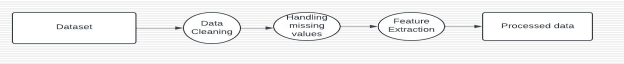
Data collection And Pre-Processing
Data Collection:This module focuses on gathering and preparing the data required for loan approval predictions. Financial data such as credit scores, income levels, loan amounts, and other key features are collected from multiple sources.
Data Cleaning: Removing or correcting inaccuracies, such as missing values, duplicates, and outliers, which could impact model performance.
Normalization/Scaling: Ensuring the data is standardized or normalized, especially for models sensitive to input ranges.

Slide 24
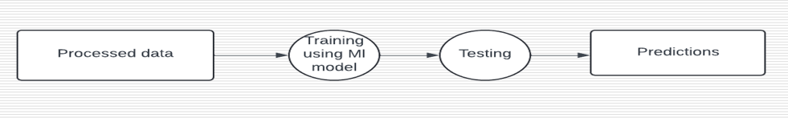
Training and Testing Module
This module is responsible for building, training, and testing multiple machine learning models (base models) to ensure they are optimized for predicting loan approvals.
Training: Different machine learning models (e.g., logistic regression, decision trees, support vector machines) are trained on the pre-processed data. Each model learns to predict loan approvals based on patterns in the historical data.
Testing: After training, the models are tested on a separate set of data (testing data) to evaluate their accuracy and generalizability.

Slide 25
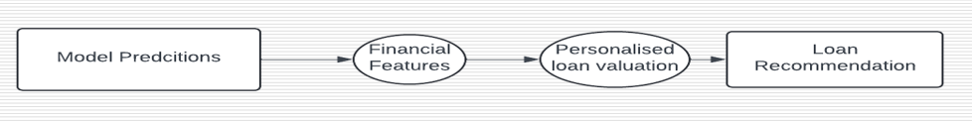
Loan Valuation or Recommendation Module
Personalized Recommendations: The system offers customized loan recommendations based on the applicant’s financial situation. This might include suggestions for improving their loan approval chances (e.g., paying off existing debt).
Risk-Based Loan Valuation: Using the predictions from the machine learning models, the system provides a recommended loan amount and terms for each applicant. Higher-risk applicants may receive lower loan amounts or higher interest rates, while low-risk applicants may receive more favorable loan terms.

Slide 26
Risk Assessment Module
Risk Analysis: The machine learning models analyze financial data (credit scores, income, debt-to-income ratio) and predict the likelihood of loan default. Higher probabilities of default indicate higher risk.
Risk Scoring: The system assigns a risk score to each applicant. The score helps the lender understand how likely the applicant is to default on the loan, guiding approval or rejection decisions.
Alert System: If certain risk thresholds are crossed, the system can flag the application for further manual review or trigger additional verification steps.

Slide 27
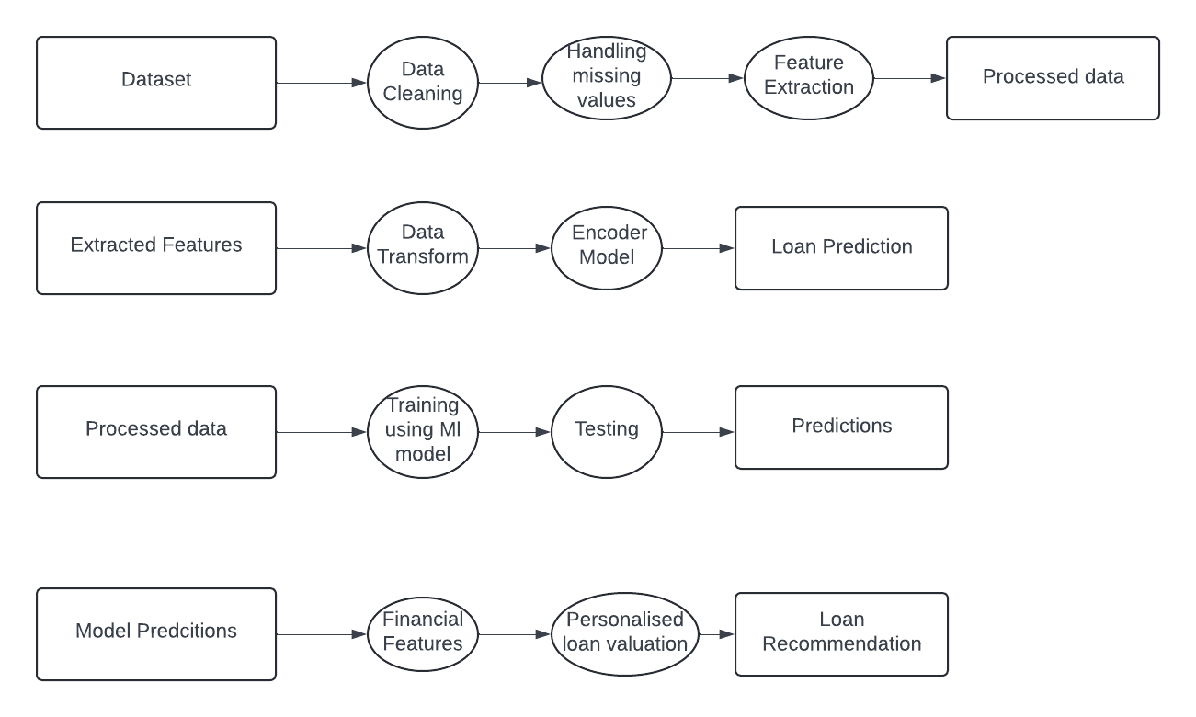
Data Flow Diagram

Slide 28
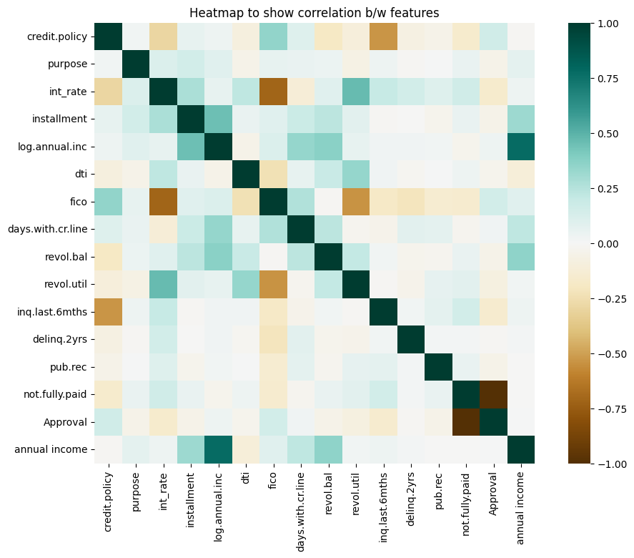
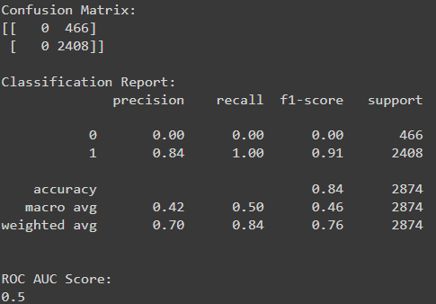
Output

Slide 29

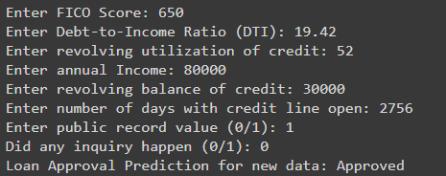

Slide 30
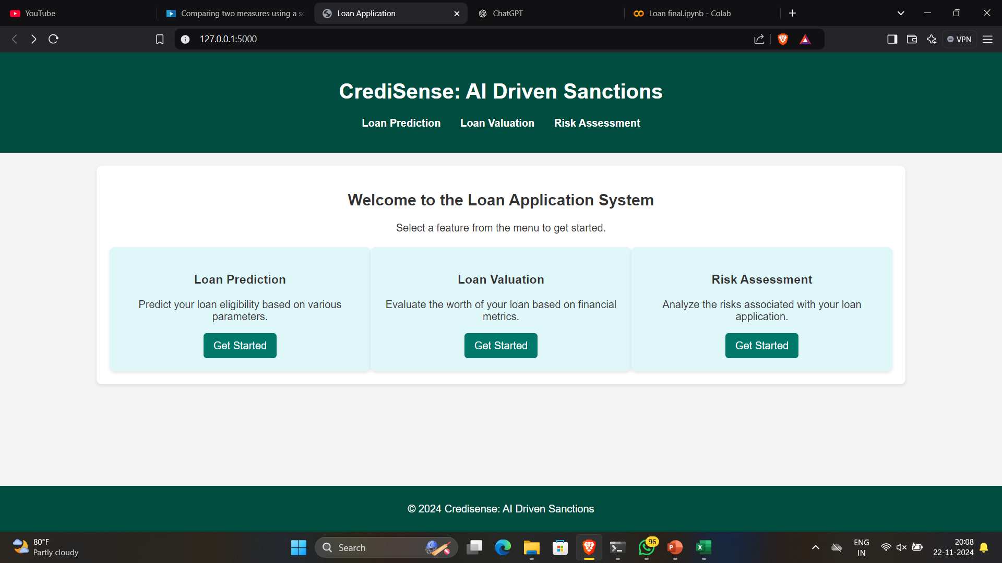

Slide 31
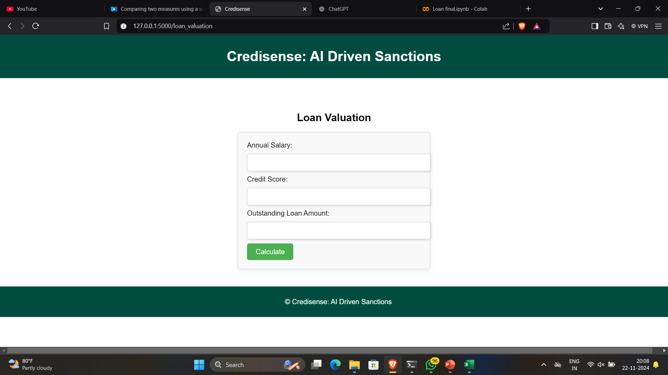

Slide 32
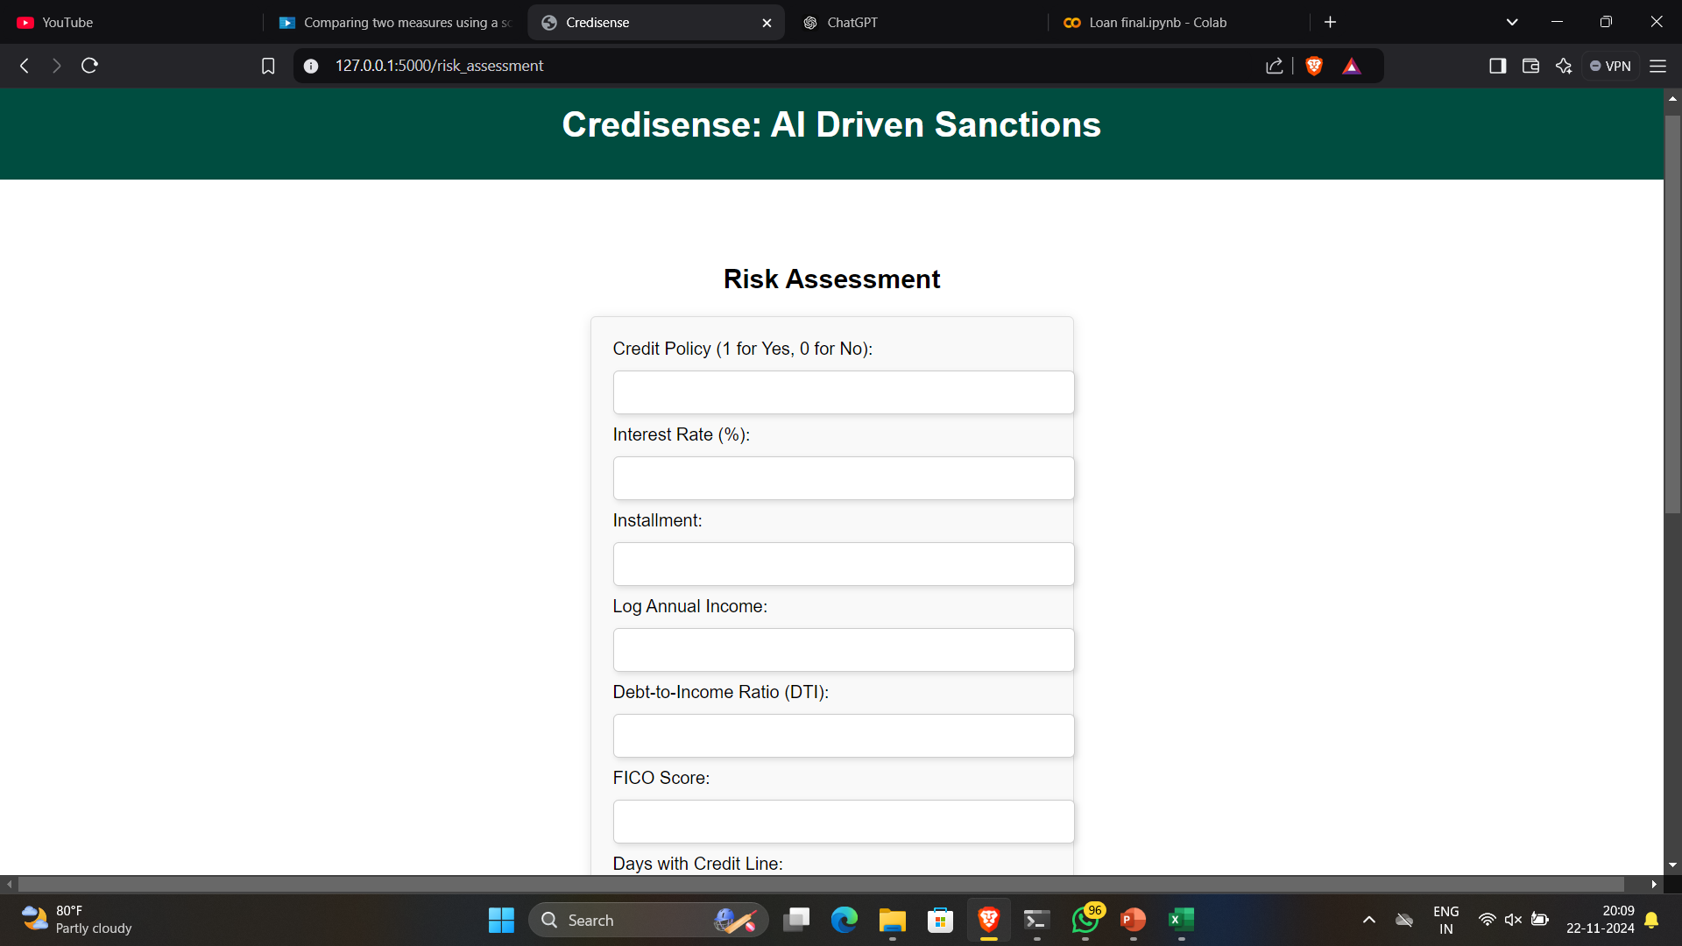

Slide 33
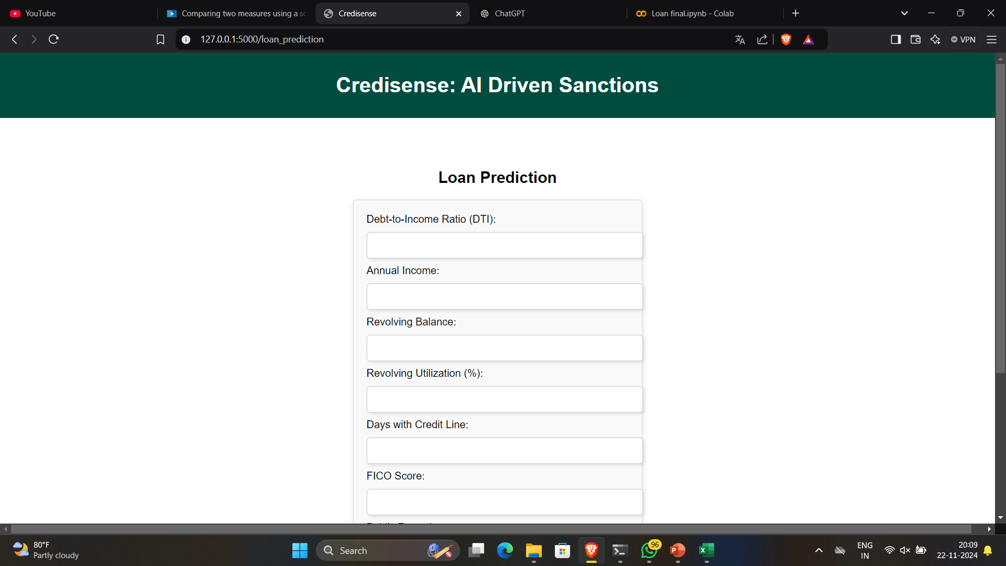

Slide 34
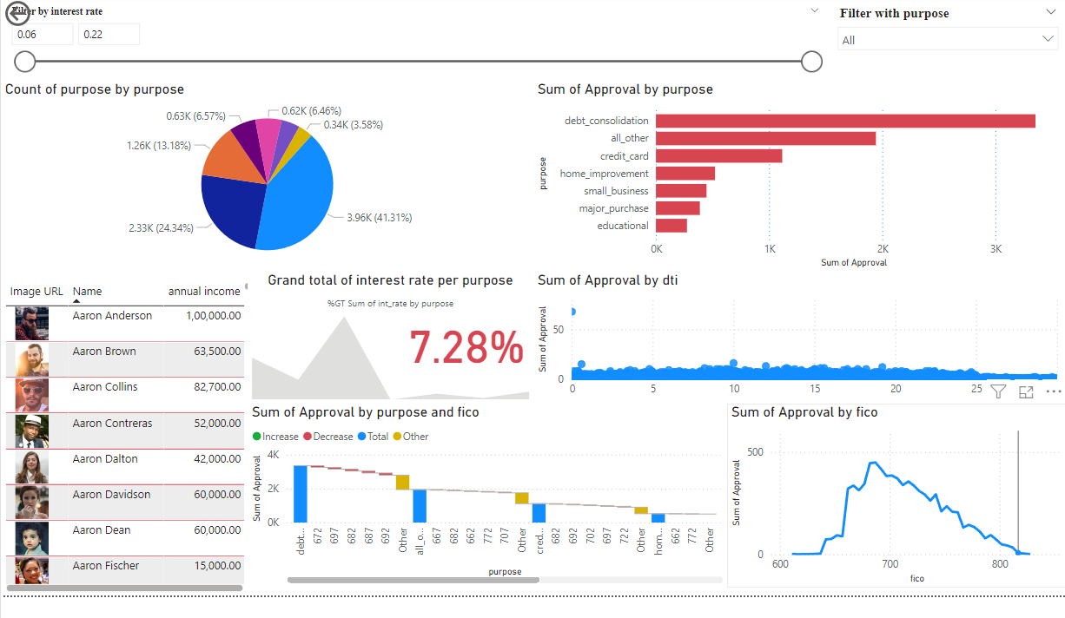
Dashboard In PowerBI

Slide 35
References
Y. Diwate, P. Rana, and P. Chavan, "Loan Approval Prediction Using Machine Learning," International Research Journal of Engineering and Technology (IRJET), vol. 8, no. 5, pp. 1741-1745, May 2021.
N. Uddin, M. K. Uddin Ahamed, M. A. Uddin, M. M. Islam, M. A. Talukder, and S. Aryal, "An Ensemble Machine Learning Based Bank Loan Approval Predictions System with a Smart Application," International Journal of Cognitive Computing in Engineering, vol. 4, pp. 327-339, Sep. 2023.
Amruta S. Aphale, " Predict Loan Approval in Bankingm System Machine Learning Approach for Cooperative Banks Loan Approval ", International Journal of Engineering Research & Technology, Vol. 9 Issue 8, August-2020.

Slide 36
Thank You

